Slide 1



BANK MARKETING DASHBOARD & INSIGHTS DATA VISUALIZATION FINAL PROJECT Prof.SundharaKumar submitted by Rupesh S Post Graduate Program in Data Science SSN School of Advanced Career Education BANK MARKETING DASHBOARD & INSIGHTS DATA VISUALIZATION FINAL PROJECT Prof.SundharaKumar submitted by Rupesh S Post Graduate Program in Data Science SSN School of Advanced Career Education
BANK MARKETING DASHBOARD & INSIGHTS
DATA VISUALIZATION FINAL PROJECT
Prof.SundharaKumar
submitted by
Rupesh S
Post Graduate Program in Data Science
SSN School of Advanced Career Education

Slide 2


PROBLEM STATEMENT:
The data is related with direct marketing campaigns (phone calls) of a Portuguese banking institution. The classification goal is to predict if the client will subscribe a term deposit.

Slide 3
DESCRIPTION ABOUT BANK MARKETING CAMPAIGN:
We start with bank marketing plan and determine the goals and bank marketing budget. We are very conscientious about saving our clients’ marketing dollars. Therefore, we always look for the most creative and economical means of reaching your goals. And where possible, we try to leverage marketing opportunities within our client base…again saving you money.
SIMPLE PLAN FOR CREATING THE BANK MARKETING CAMPAIGN:
Explore your goals. Your goals determine how we will create a marketing campaign.
Establish your target market. Who is most likely to have the propensity to purchase your product or service?
Consider your current customer base. Your customers are most often your first choice and best source for increasing share of wallet economically
Determine your current and new markets. Where are you most likely to find your target market and reach your goals?
Prepare a creative brief that outlines your unique marketing situation, proposed campaign, goals, action items and time frames.

Slide 4

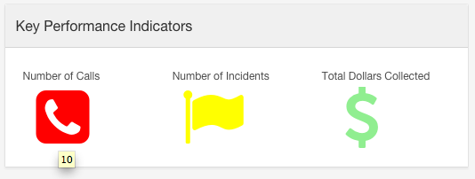
KPIs:[KEY PERFORMANCE INDICATOR]
THROUGH CONTACTS
THROUGH CAMPAIGN
BASED ON THE TERM DEPOSIT

Slide 5


KEY FINDINGS:
1)THROUGH CONTACTS:
Contact types are classified into two categories which are cellular and telephone.
Based on the cellular contact, the most of the cellular contact are good reach in the month of July, may and august and telephone contact are good reach in the month of may. Therefore, the success rate of direct marking campaign are mostly done by the cellular contact rather than telephone.

Slide 6
2)THROUGH CAMPAIGNS:
In previous campaign, the success rate of term deposit subscription are very less due to awareness of their interest rate and brand.
In after campaign, the success rate is gradually increased and bank can help a customer, such as operating account, making transfer and paying standard orders.

Slide 7

3)BASED ON TERM DEPOSIT SUBSCRIPTION:
out of 41188 clients 4640 have subscribed to term deposit of which the people holding university degree and working as admin are the maximum. The subscription happens the most in the month of may.

Slide 8
INSIGHTS:
Call them before 40 years age
Call on Thursday & Tuesday
Call during on summer & spring months
Expert call length to vary by job
Call at least 4 times

Slide 9
CONCLUSION:
The following variables seem to be the most relevant inputs in analyzing the Success rate of bank direct marketing campaign
• Duration • P-days • Month • Age • Contact • Job
A client is more likely to subscribe to term deposit if customer talks for more duration.
Campaign is more likely to be successful during May, June, July (end of every trimester).
A Customer with default credit would not go for term deposit subscription.
Campaign reach is good among blue collar, admin,retired and housemaids.

Slide 10
THANK YOU!!!

